Slide 1

Unit-1 Introduction to Internet of Things
Internet of Things (IoT)
DU #2101CS631
Prof. Bhushan D. Joshi
Computer Engineering Department
bhushan.joshi@darshan.ac.in
+91 8485979997

Slide 2

Outline
IoT Introduction: Characteristics & Components
IoT stack and IoT levels
Physical Design of IoT
IoT Protocols
IoT communication models and Communication APIs
Enabling technologies
Domain specific IoT Application areas
Looping

Slide 3
Unit 1: Introduction To Internet Of Things
IoT Introduction: Characteristics & Components
Enabling technologies
Domain specific IoT Application areas
IoT stack and IoT levels
Physical Design of IoT
IoT Protocols
IoT communication models and Communication APIs

Slide 4
Introduction To IoT
Section - 1

Slide 5
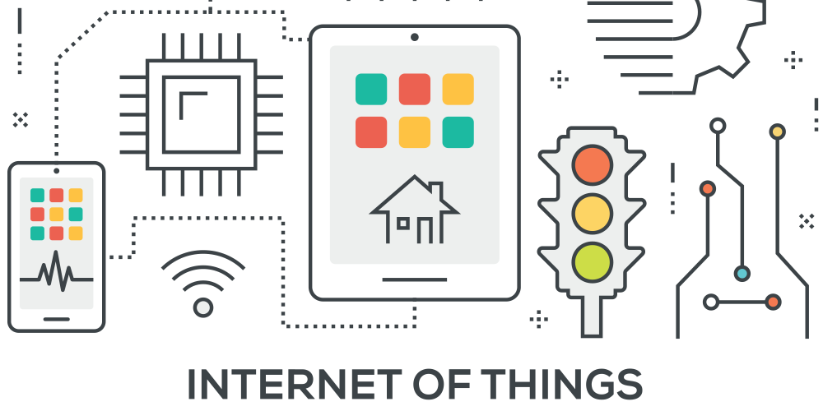
IoT : Internet of Things
The Internet of Things (IoT) refers to a network of physical objects that are connected to the Internet so that they can exchange data and information in order to improve productivity, efficiency, services, and more.
A network of physical objects or ‘things’ that can interact with each other to share information and take action.
The interconnection of uniquely identifiable embedded computing devices within the existing Internet infrastructure.
The Internet of Things (IoT) refers to an integrated system of physical objects (things) embedded with sensors, software, and other technologies for the purpose of connecting and exchanging data within the systems over the “internet”.

Slide 6

IoT : Everything Will be Connected
The physical objects used in the IoT range from ordinary household objects to sophisticated industrial tools connected to the internet via embedded devices.
IoT is one of the fastest emerging technologies, providing enormous beneficial opportunities for individuals, society, and governments.
IoT is not a single technology, it’s a combination of technologies and domain knowledge. As a result, engineers from different domains have to work together for building a complete IoT product.
Life would be governed entirely by Internet and IoT in the near future.
IoT is a sensor network of billions of smart devices that connect people, systems and other applications to collect and share data.

Slide 7
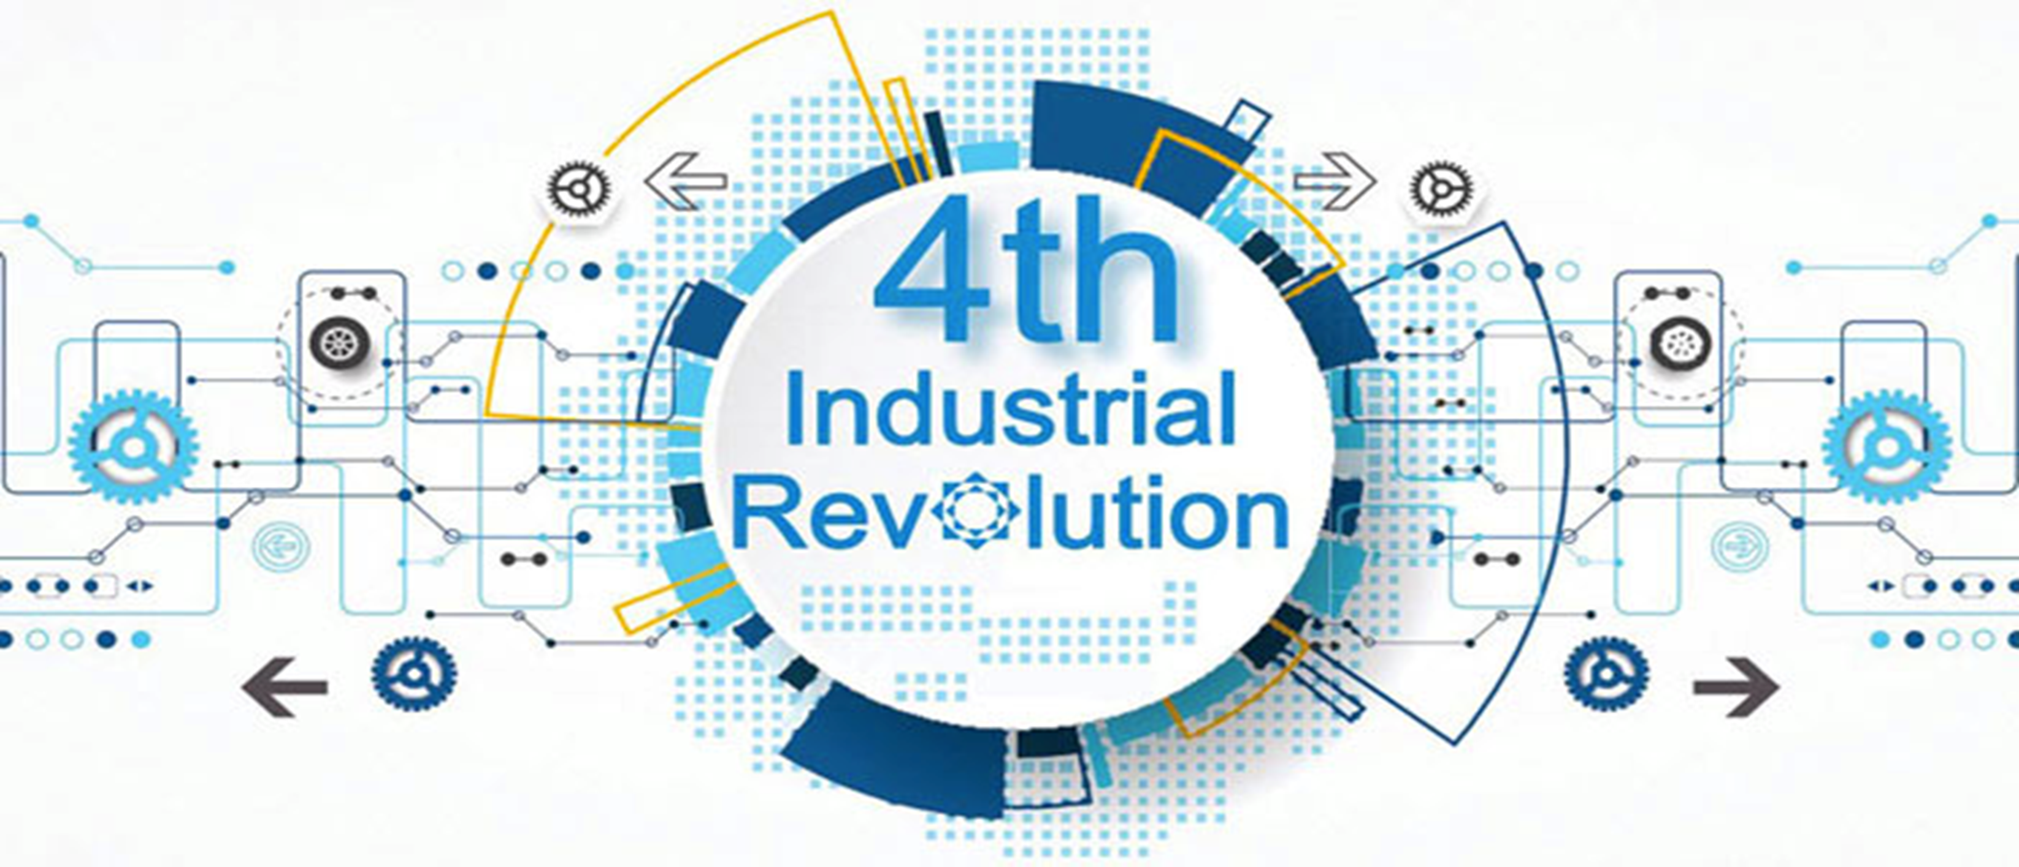
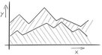

Introduction to Internet of Things (IoT): New Age
Internet of Things (IoT) is an emerged as the 4th Industrial Revolution.
There are multiple ways to define IoT, but the basic of all the definitions remains the same.
The IoT is not just limited to the connected or networked devices, but in a broad way IoT devices exchange meaningful information from one device to another to get desire result.

Slide 8
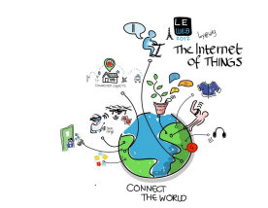
Things in IoT
A Thing in the IoT can be any natural or man-made object that can be assigned an IP address and is able to transfer data over a network
A person with a heart monitor implant
A farm animal with a biochip transponder
An automobile that has built-in sensors to alert the driver when tire pressure is low
IoT is a sensor network of billions of smart devices that connect people, systems and other applications to collect and share data.
The term "Things" in the Internet of Things refers to anything and everything in day to day life which is accessed or connected through the internet.

Slide 9
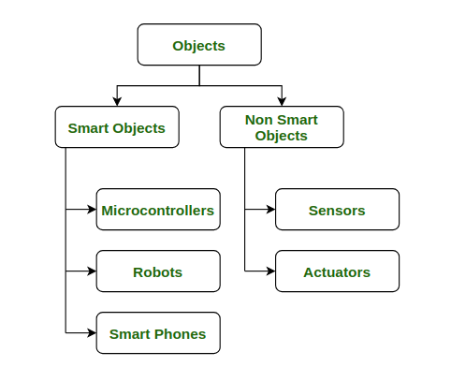
Things in IoT
Objects with intelligence or Smart Objects.
Objects without intelligence or Non-Smart Objects.

Slide 10
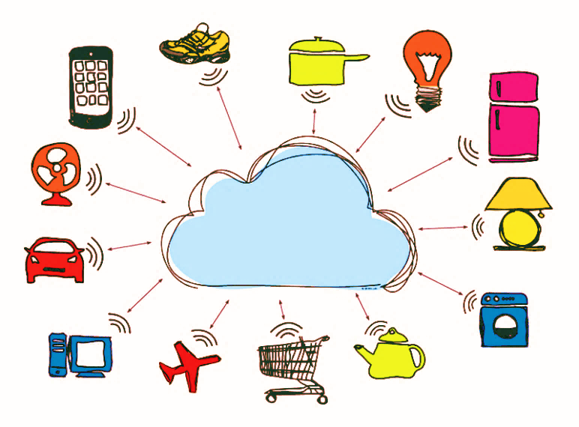
Things in IoT
The “Thing” in a network can be monitored/measure.
For example, a temperature sensor could be a thing.
Things are capable of exchanging data with other connected devices in the system. The data could be stored in a centralized server (or cloud), processed there and a control action could be initiated.
The data from these sensors are collected and sent it to the cloud or stored it in local server for data analysis. Based on the data analysis, the control action would be taken.

Slide 11
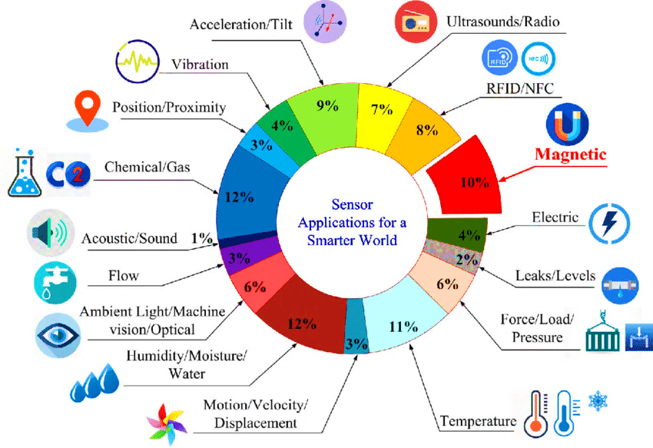
Things in IoT : Sensor

Slide 12
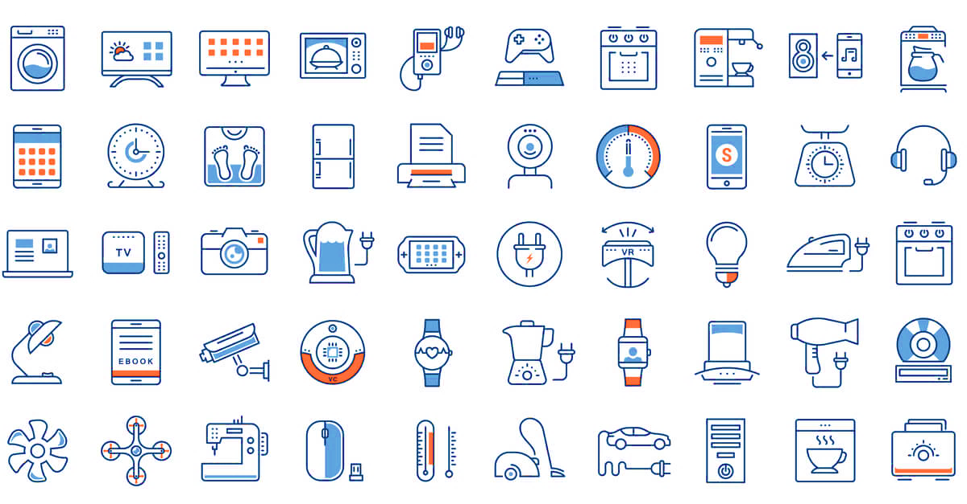
Things in IoT
Not just sensors, the following can also be called as things:
Industrial motors
Wearable's (e.g., watch)
Vehicles
Shoes
Heart monitoring implants
(e.g., pacemaker, ECG real-time tracking)
Biochip transponders
(for animals in farms)
Automobiles with built-in sensors (automobile feature real-time monitoring)
Food/perishables quality

Slide 13
Things in IoT : A Smart Home
In IoT-based HOME AUTOMATION, the “Things” could be the following:
Lighting control and automation devices
Ventilation devices
Air conditioning [heating, ventilation and air conditioning (HVAC)] systems
Appliances such as washer/dryer
Air purifiers
Ovens or refrigerators/freezers that use Wi-Fi for remote monitoring
Security cameras

Slide 14
IoT Components
Section - 2

Slide 15
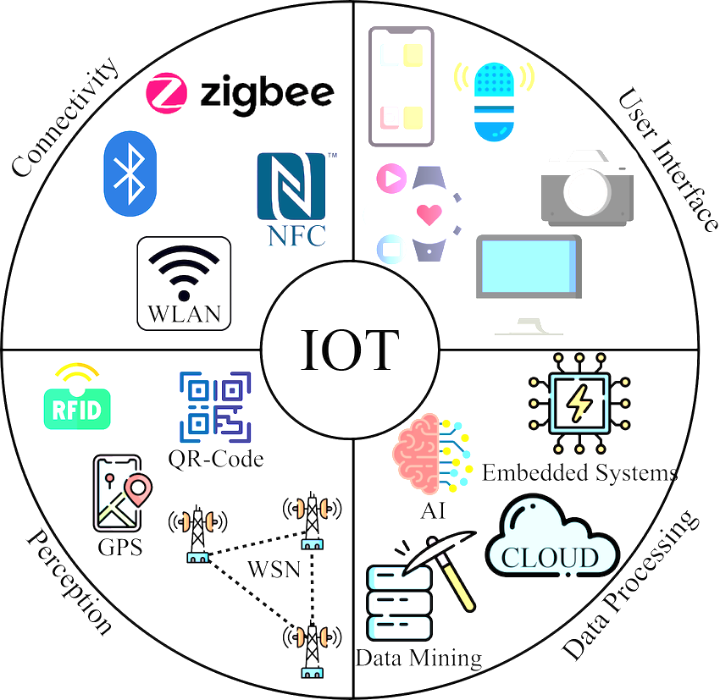
Components of IoT
1 Things or Device
2 Gateway
3 Cloud
5 Analytics
6 User - Interface
4 Connectivity

Slide 16
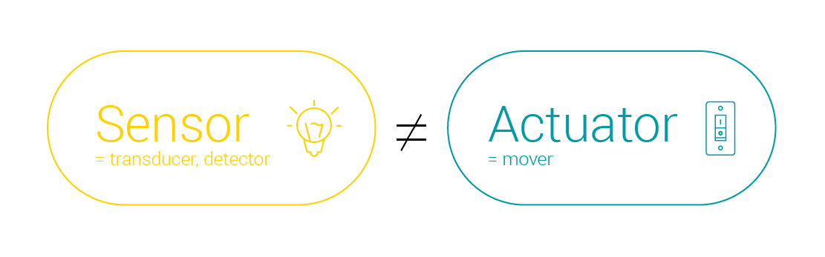
Components of IoT : Things or Devices
Sensor
The sensor is the layer that connects the IoT device to the outer environment or human being.
As the name suggests, it senses the changes and sends data to the cloud for processing.
These sensors continuously collect data from the environment and transmit the information to the next layer. Example: pressure sensor, temperature sensor, and light intensity detectors.
Sensors collect data from the environment.
Actuator
An actuator is a device that produces a motion by converting energy and signals going into the system.
Example : Motor, LED light
Actuators performs the action

Slide 17
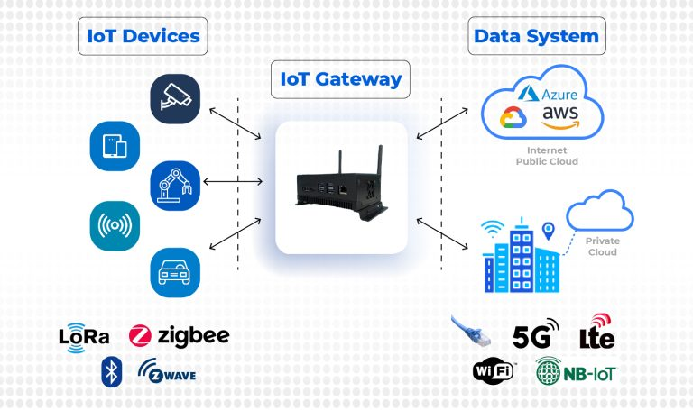
Components of IoT : Gateway
IoT Gateway serves as a bridge between the devices and the cloud, allowing for communication, data collection, and data processing. Gateway facilitates Data Flow Management And Protocol Layer to transfer data from one device to another.
It translates the network protocols for devices and provides encryption for the data flowing in the network. It’s like a layer between the cloud and devices that filter away cyber attacks and illegal data access.

Slide 18
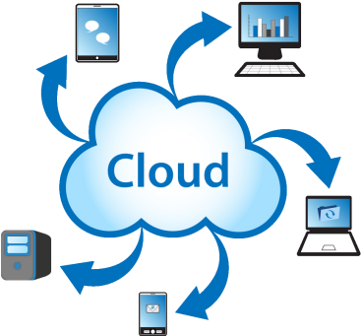
Components of IoT : Cloud
IoT systems send massive data from devices, and this data needs to be managed efficiently to generate meaningful output. Cloud is one of the best option.
To store this huge amount of data.
It provides tools to collect, process, and store data.
Data is readily available and remotely accessible through the internet.
It also provides a platform for analytics.
IoT cloud is a sophisticated, high-performance network of servers to perform high-speed processing of a huge amount of data.

Slide 19
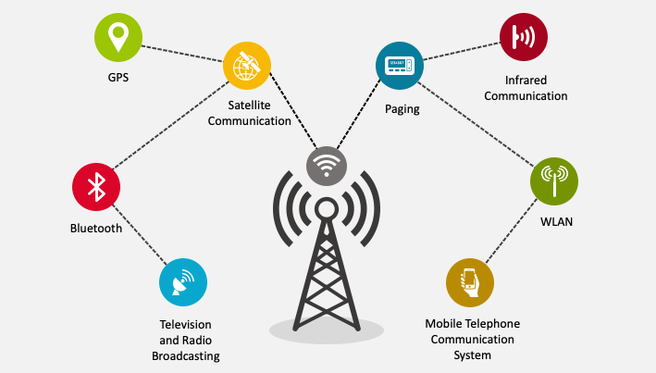
Components of IoT : Connectivity
The data collected by sensors need to be sent to the cloud for analytics.
Data needs the internet as a medium to be transfer from one device to another.
IoT devices need to be connected to the internet all the time, Connectivity is an important requirement of the IoT infrastructure.
Things of IoT should be connected to the IoT infrastructure; anyone, anywhere, anytime can connect, this should be guaranteed at all times.
Networks like Wi-Fi, Bluetooth, WAN, satellite networks make it easy to stay connected.
Data can be sent to the cloud through these networks.

Slide 20
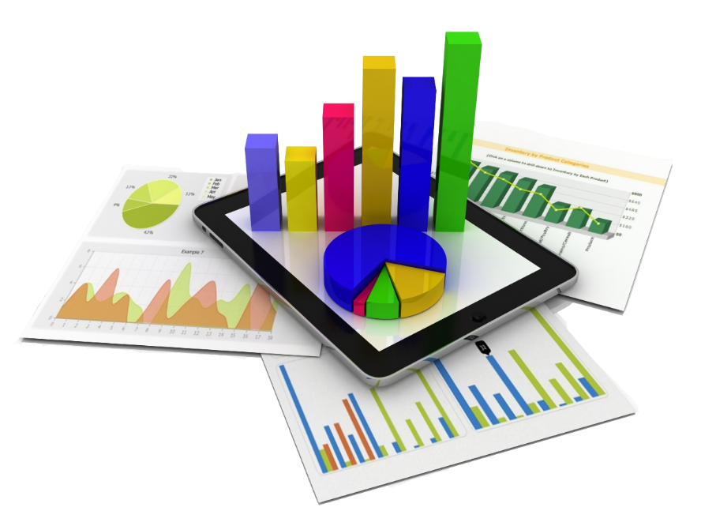
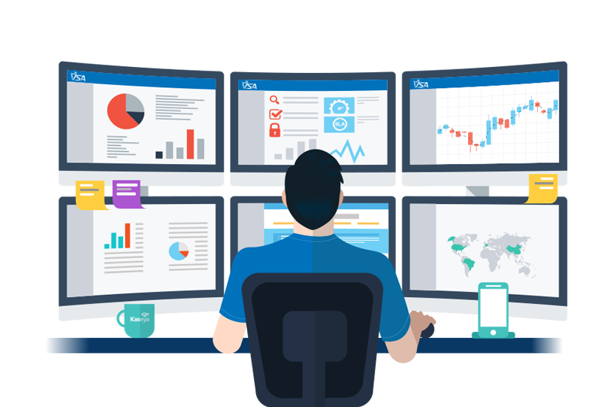
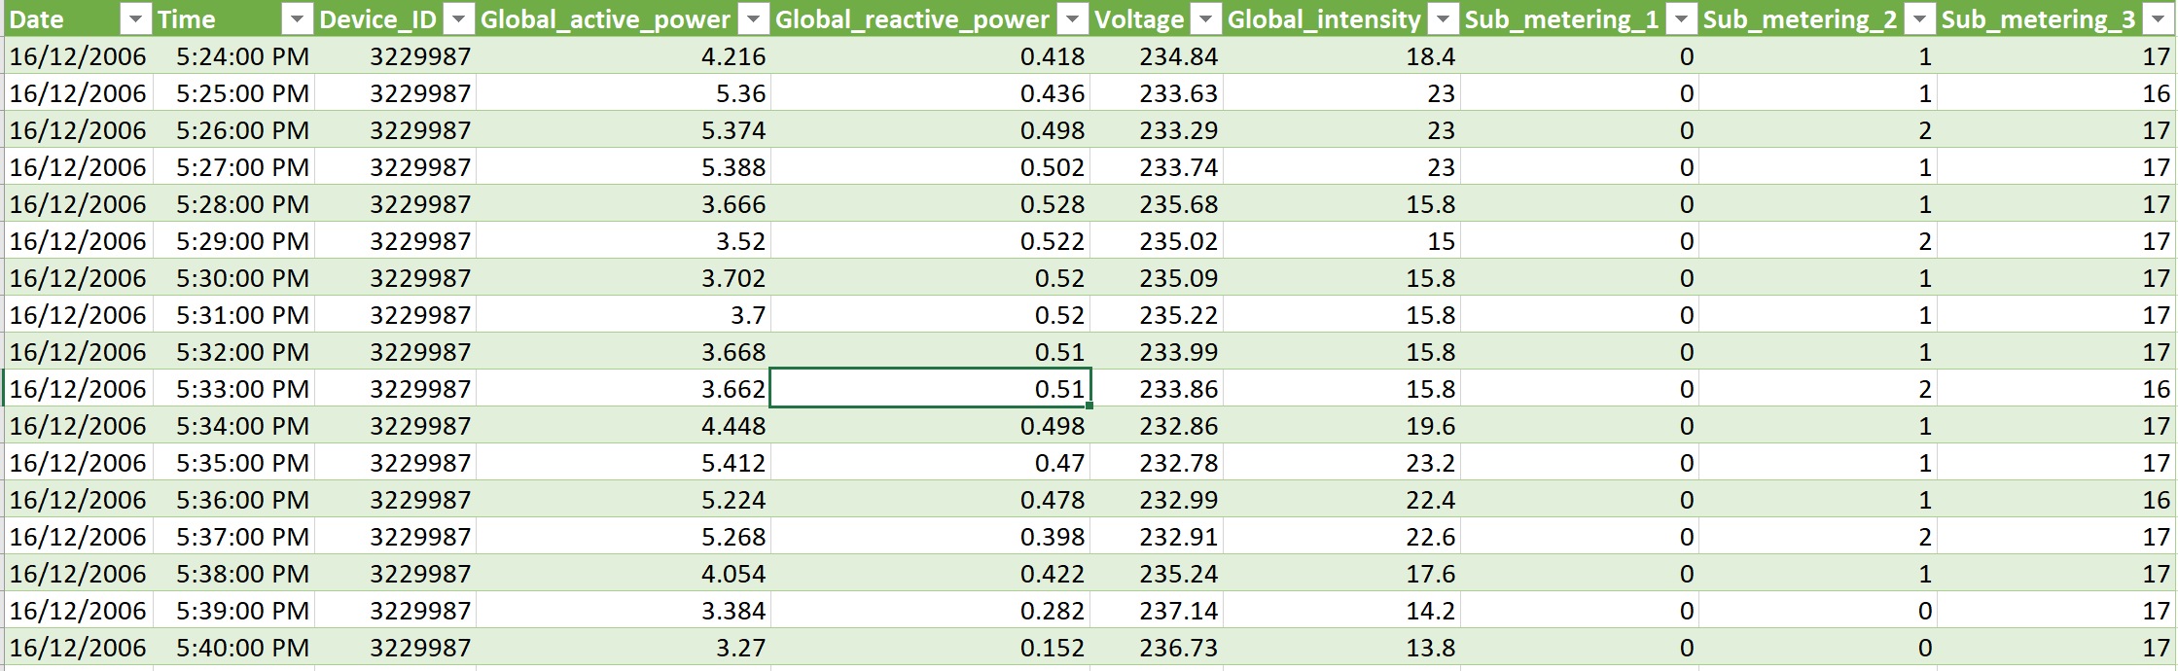
Components of IoT : Analytics
Analytics is the process of converting raw data into some meaningful form.
IoT analytics supports real-time analysis, which captures real-time changes and irregularities.
The data is then converted into a format that is easy to understand by the end-user.
As a result, users or businesses can analyse the trends shown in reports, predict the market and plan ahead for a successful implementation of their ideas.

Slide 21
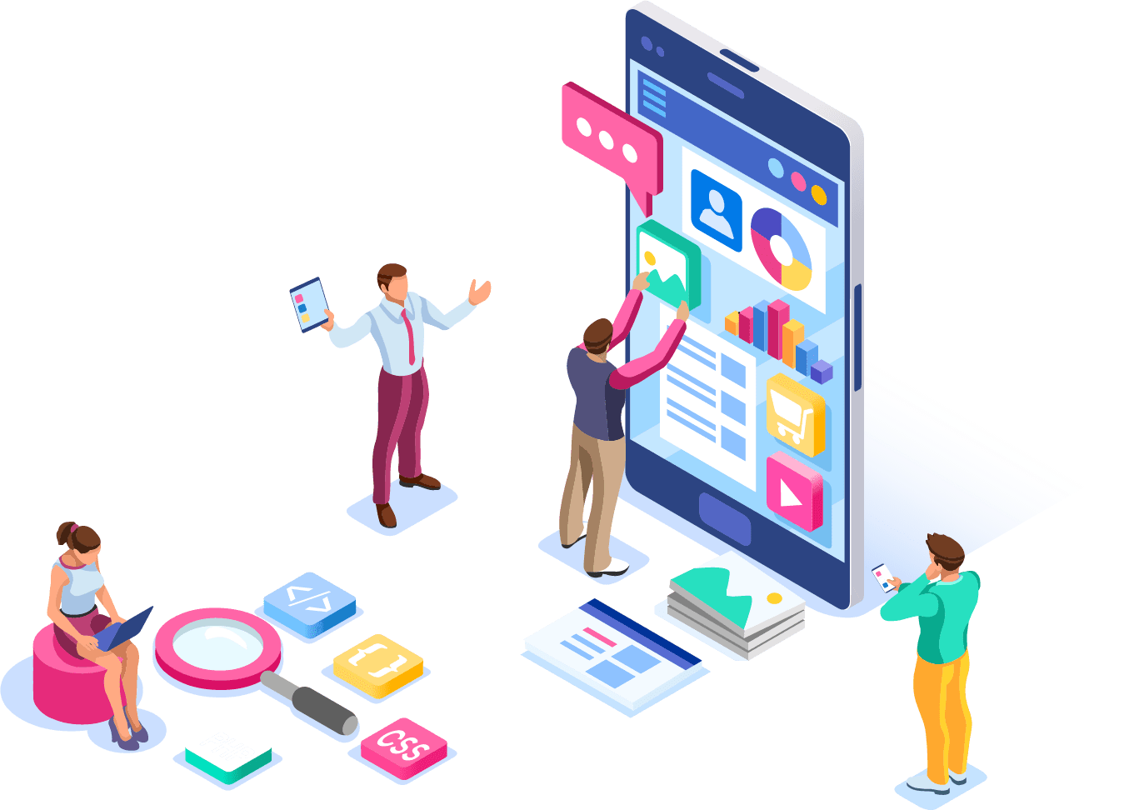
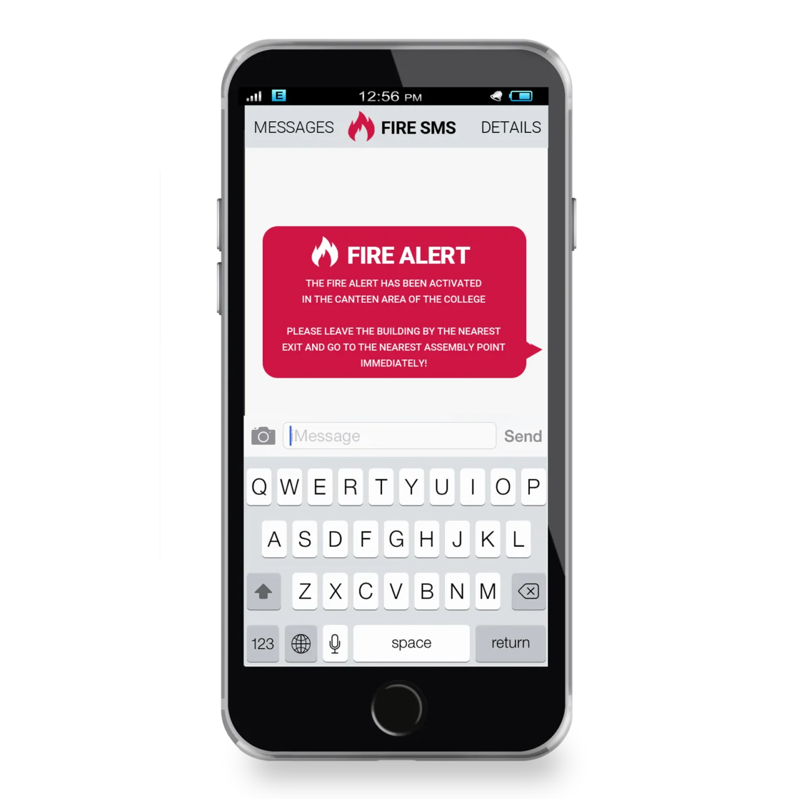
Components of IoT : User interface
The User interface is a visible, tangible part of IoT systems. It is that part of the system which interacts with the end-user.
The information can be made available either in report format or in the form of some actions like trigger an alarm, a notification, etc.
The user can also choose to perform some actions.
Therefore, it is important to create a user-friendly interface that can be used without much effort and technical knowledge.
The easier the user interface is, the more successful the product is.

Slide 22
IoT Characteristics
Section - 3

Slide 23
IoT Characteristics
IoT Characteristics
Intelligence & Identity
Scalability
Dynamic and Self-Adapting
Security / Safety
Architecture

Slide 24
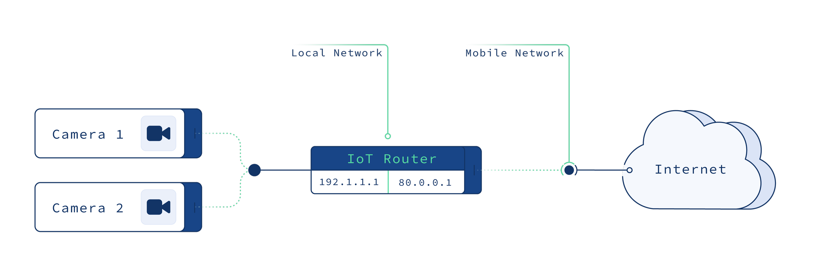
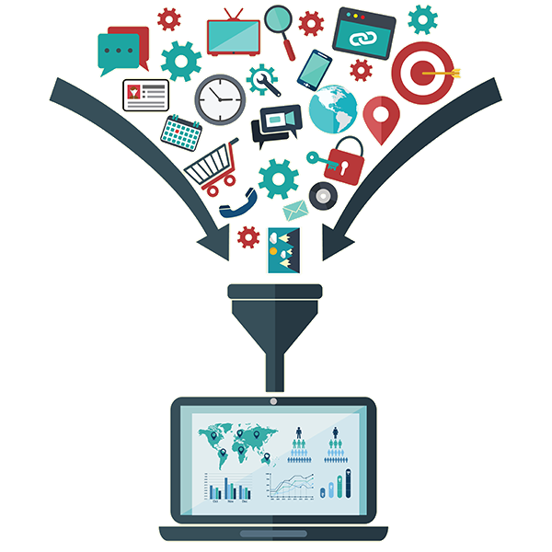
Characteristics of IoT : Intelligence and Identity
The extraction of knowledge from the generated data is very important.
For example, a sensor generates data, but that data will only be useful if it is interpreted properly.
Each IoT device has a unique identity.
This identification is helpful in tracking the equipment and at times for querying its status.

Slide 25
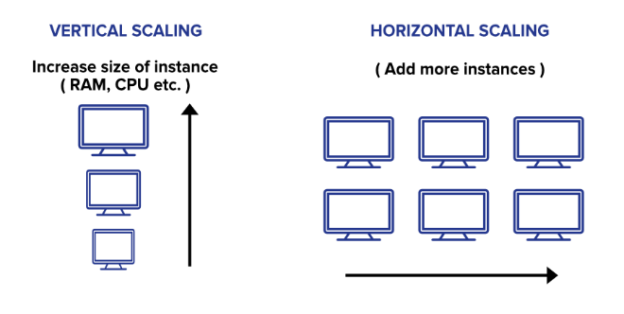
Characteristics of IoT :Scalability
The number of elements (devices) connected to IoT zone is increasing day by day. Therefore, an IoT setup should be capable of handling the expansion.
Vertical Scaling : Expand capability in terms of processing power, Storage, etc.
Horizontal Scaling : By multiplying with devices numbers or cloning system.

Slide 26
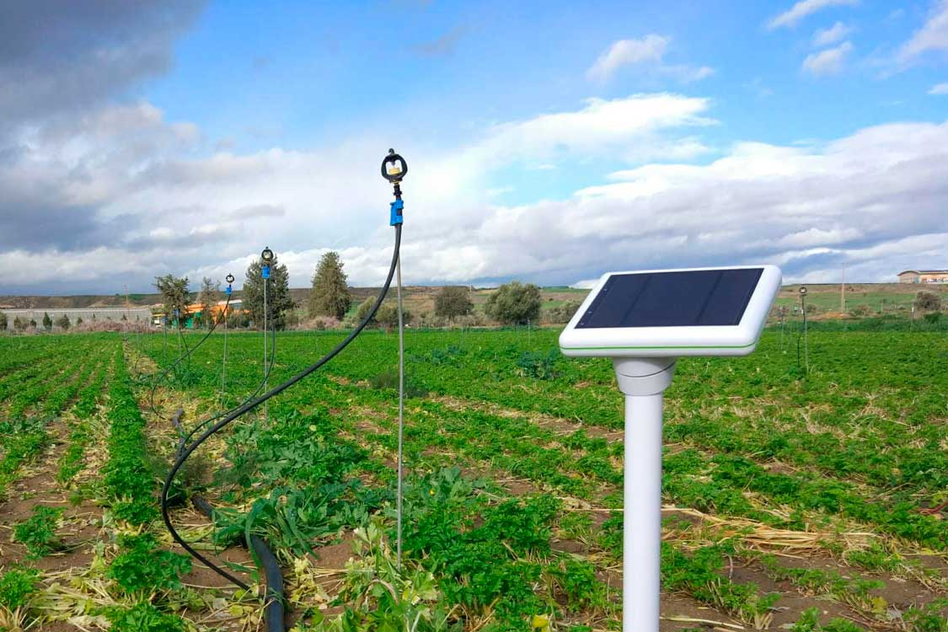
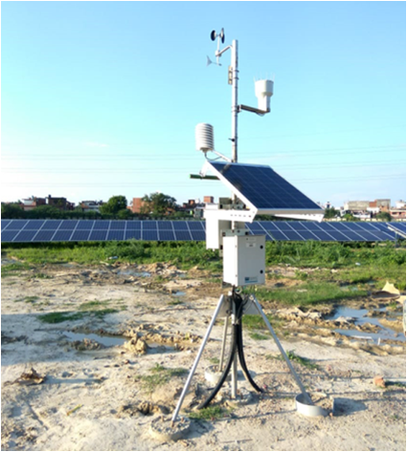


Characteristics of IoT : Dynamic & Self Adapting
IoT devices should dynamically adapt themselves to the changing surroundings.
For example surveillance camera. It should be flexible to work in different weather conditions and different light situations (Day/Night).
Weather stations can automatically adjust climate conditions in greenhouses based on instructions.
Temperature monitors can help farmers identify weather trends and detect abnormalities. They can also help farmers adjust watering schedules and ensure that crops receive the right amount of water at the right time.

Slide 27
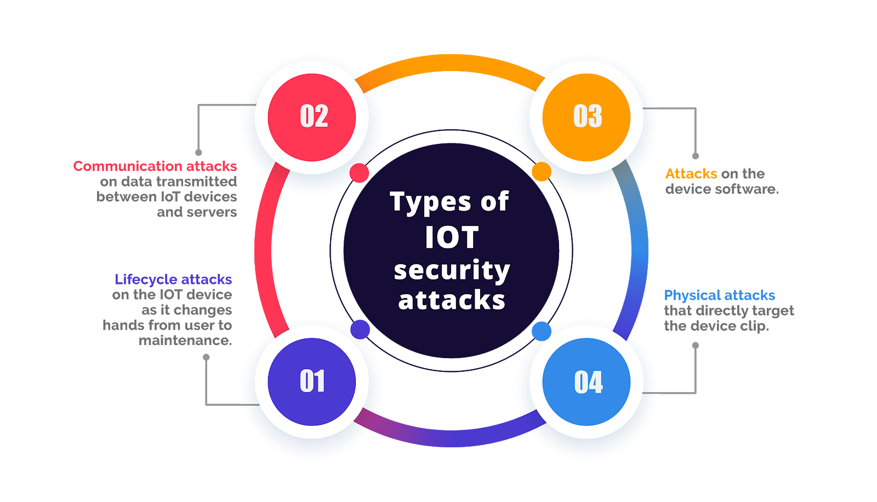
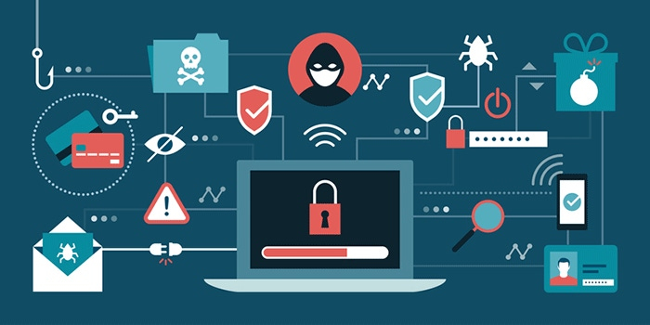
Characteristics of IoT : Security / Safety
IoT security (internet of things security) is the technology segment focused on safeguarding connected devices and networks in IoT.
Due to the unconventional manufacturing of IoT devices and the vast amount of data they handle, there's a constant threat of cyber attacks.
Sensitive personal details of a user might be compromised when the devices are connected to the Internet. So data security is a major challenge.
This could cause a loss to the user data.
The Equipment in the huge IoT network may also be at risk

Slide 28
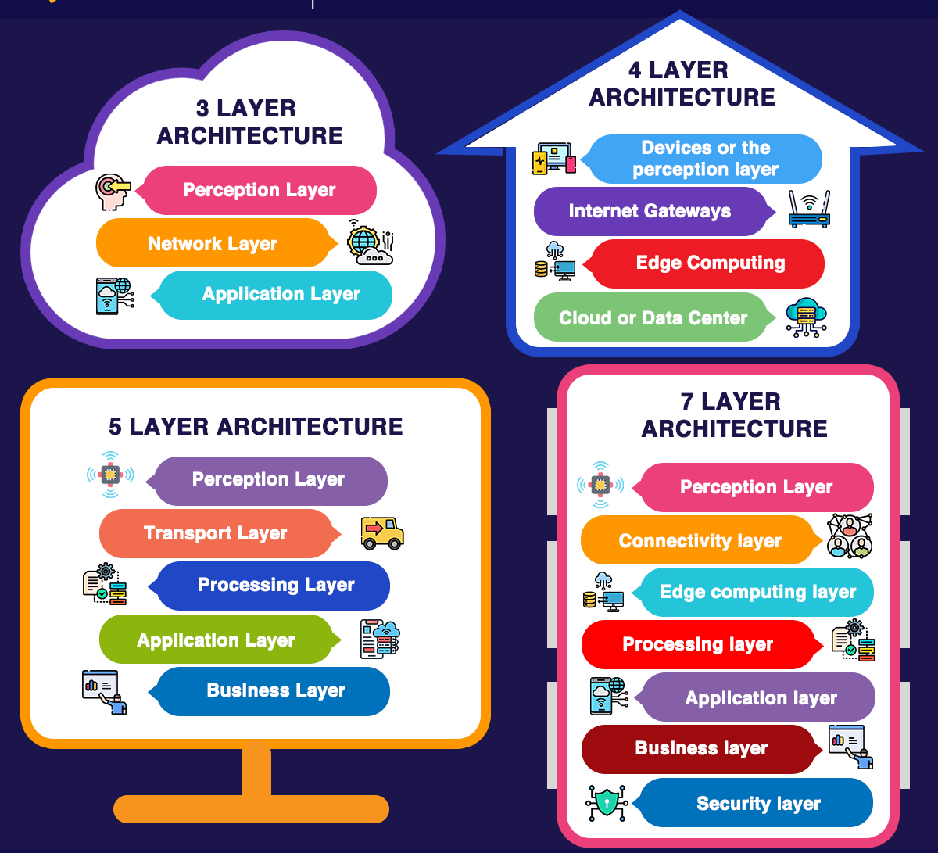
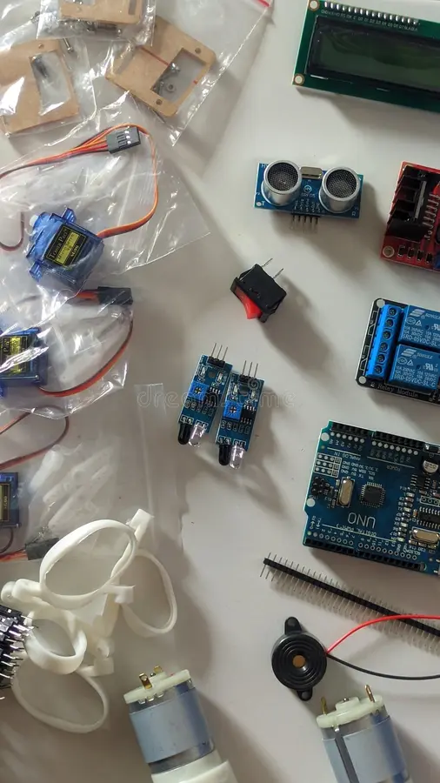
Characteristics of IoT : Architecture
IoT architecture is yet not uniformed and standardized.
It should be hybrid, supporting different manufacturer’s products to function in the IoT network.

Slide 29
IoT Stack – 7 Layer Architecture
Section - 4

Slide 30
IoT Stack – 7 Layer Architecture
IoT Stack
Layer 6 (User Experience Layer)
Layer 1 (Physical or Sensor Layer)
Layer 7 (Application Layer)
Layer 5 (Session/Message Layer)
Layer 4 (RF Layer)
Layer 3 (Hardware Interface Layer)
Layer 2 (Processing and Control Action layer)

Slide 31

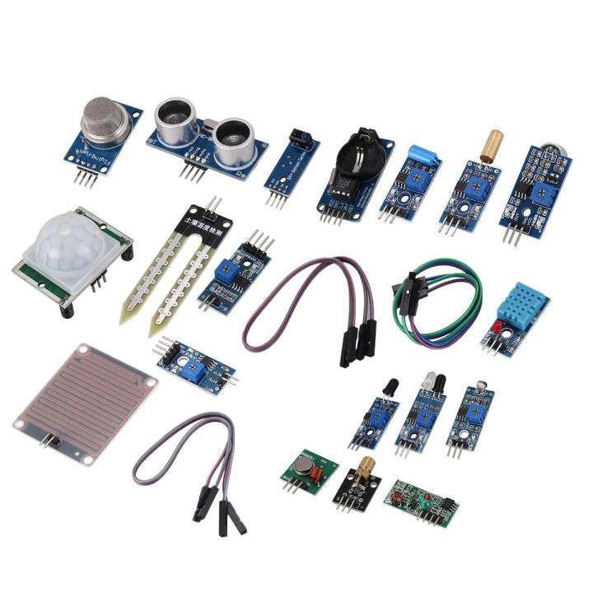
IoT Stack - Layer 1 (Physical or Sensor Layer)
Physical components, which mainly includes sensors and actuators.
Example : Temperature sensor, pressure sensor, humidity sensor, etc.
These all can be referred as physical layer components.
This layer is responsible for data collection and action execution.
Selection of sensors is important and choosing an appropriate sensor is the challenge in this layer.
Function of layer :
Action execution (via Actuators)
Sensing data (via Sensors)

Slide 32
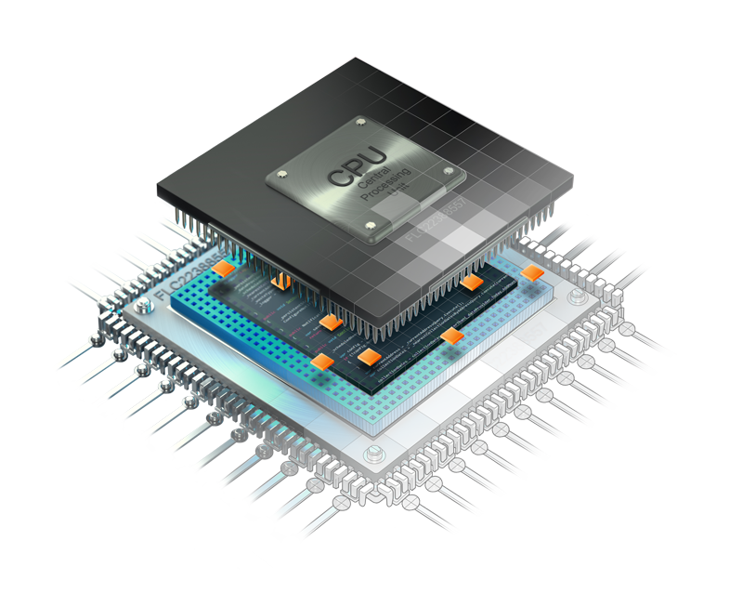
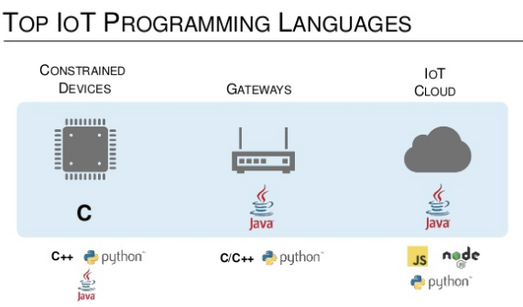
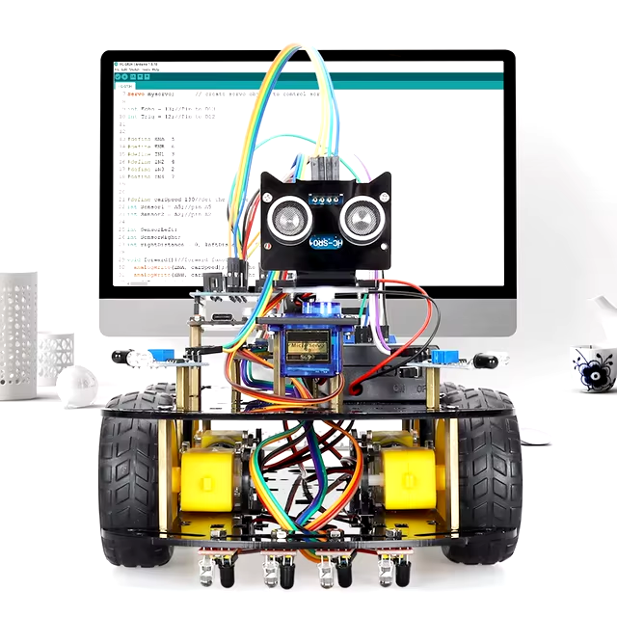
IoT Stack - Layer 2 (Processing and Control Action Layer)
This important layer contains core components of IoT system.
The microcontrollers or processors are found in this layer.
The microcontrollers received data from the sensors.
A variety of development kits are available in the market
Arduino, Raspberry Pi, Node MCU, PIC, ARM development boards, etc.
Microcontroller/Processor and operating system play vital role at this layer.
Data collected from the sensors is processed in this layer.

Slide 33
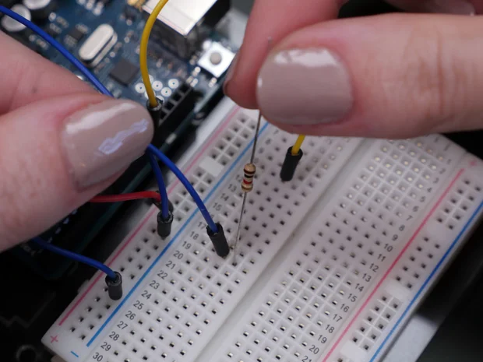
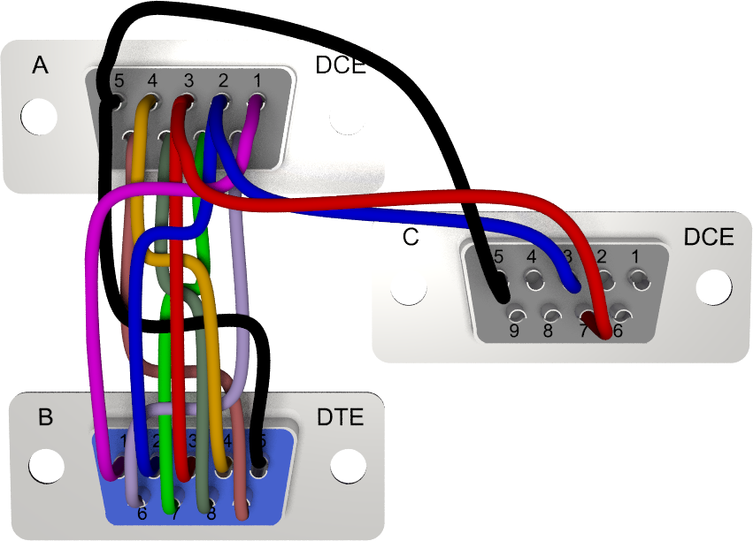

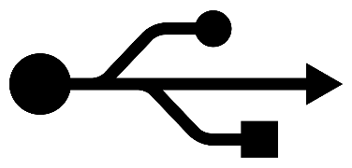
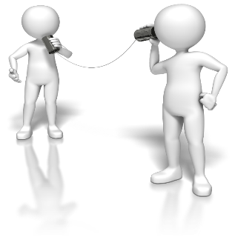
IoT Stack - Layer 3 (Hardware Interface Layer)
Hardware Interface Layer connects the components.
Hardware components and communication standards such as
RS232
CAN
SPI
SCI
I2C, etc. occupy this layer.
All these components ensure flawless communication

Slide 34
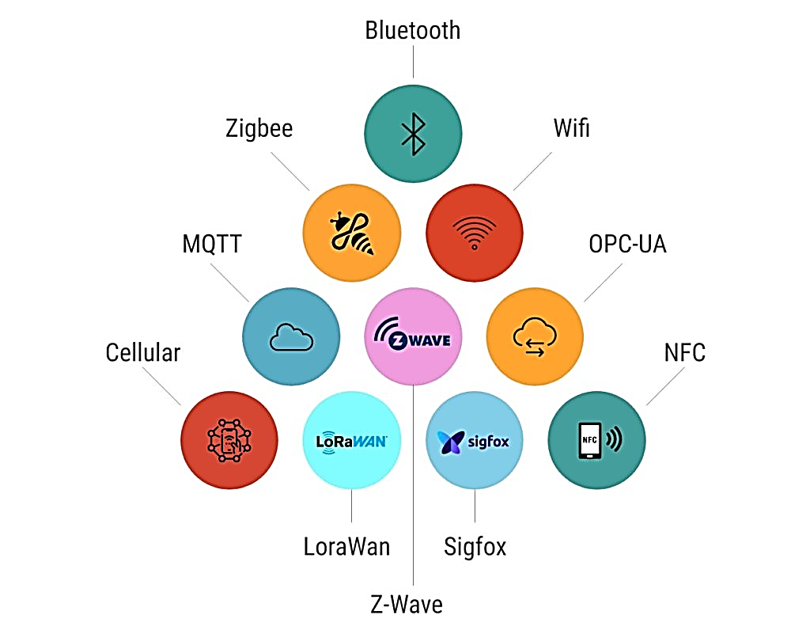
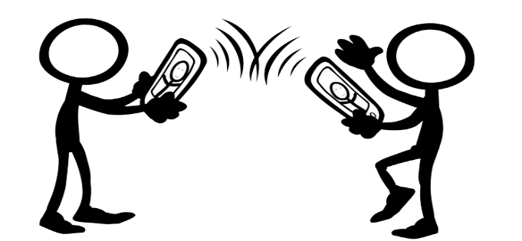
IoT Stack - Layer 4 (RF Layer)
RF layer does communication of data using radio frequency based Electromagnetic (EM) waves.
RF plays a major role in the communication channel – whether it is short range or long range. Protocols used for communication and transport of data based on RF are listed in this layer.
Some famous and common protocols are Wi-Fi, NFC, Bluetooth, Zig-bee, LoRa etc.

Slide 35
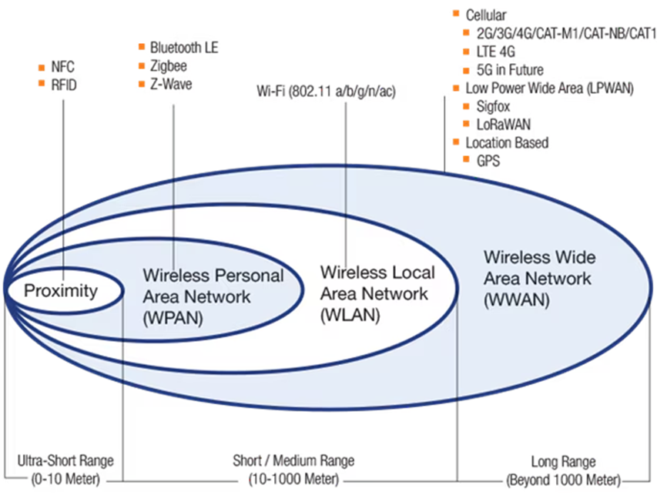
Choose an RF Protocol for an IOT Application

Slide 36
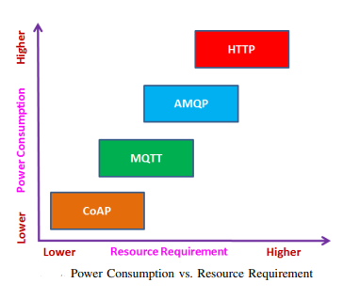
IoT Stack - Layer 5 (Session/Message Layer)
A protocol in the Internet of Things (IoT) that manages and establishes communication sessions between users on different machines is a part of session /message layer.
The Session Layer manages the connection between two endpoints of a network by controlling data between sender and receiver
The session layer protocols are responsible for the actual transmission of data in the IoT ecosystem. Layer 5 (session layer) deals with the various messaging protocols as MQTT, CoAP.

Slide 37
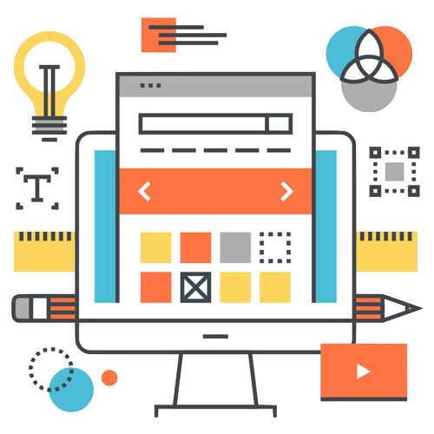

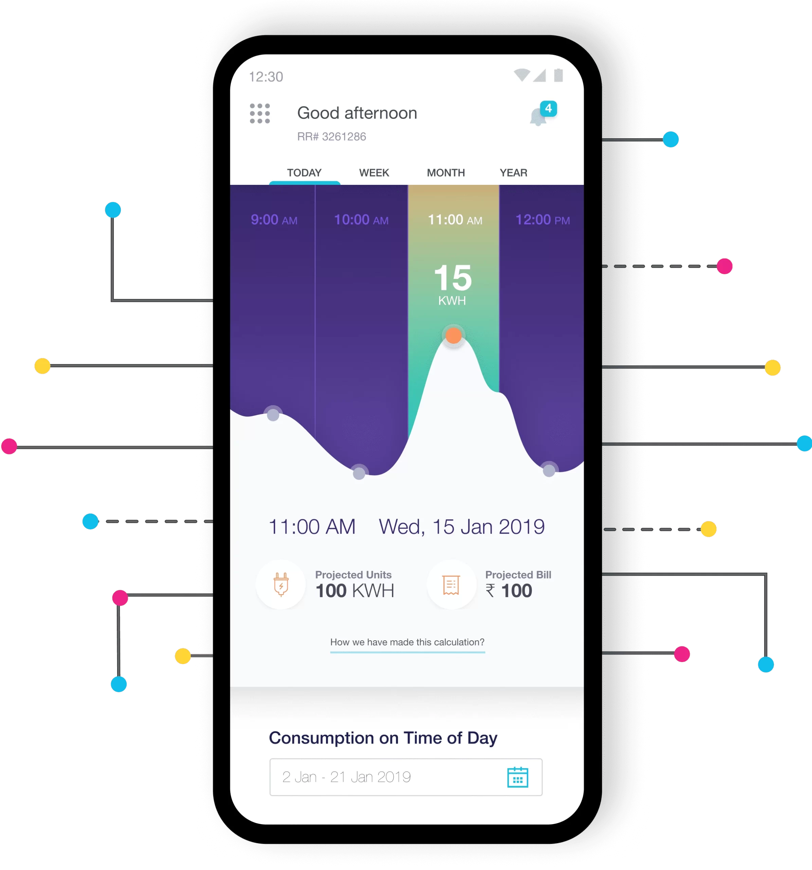
IoT Stack - Layer 6 (User Experience Layer)
This layer deals with providing best experience to the end users of IoT products.
The 6th layer takes care of rich UI designs with lots of features, which provide a pleasing experience while using the service/system or product.
Object-oriented programming languages, scripting languages, analytics tools, etc. all should be included in this layer.
This is also known as User Experience and Visualization Layer.

Slide 38
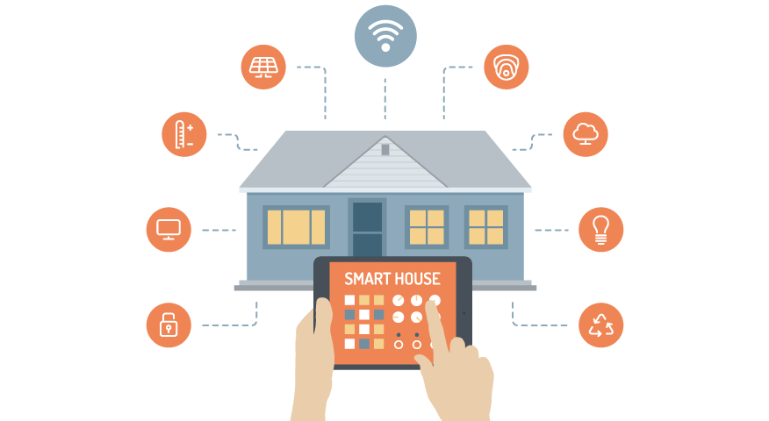
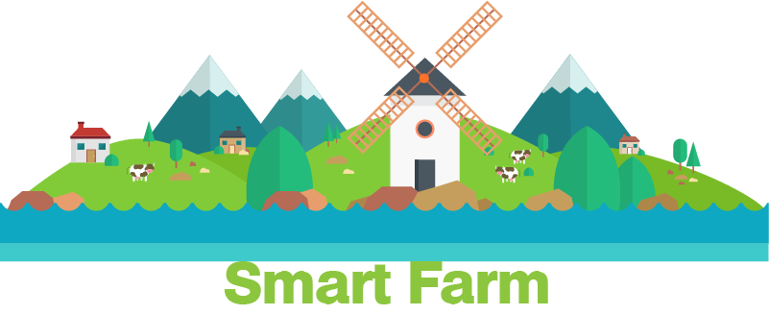
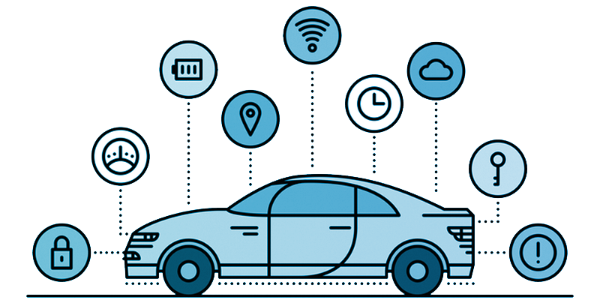
IoT Stack - Layer 7 (Application Layer)
Everything comes to perfection at this layer.
This layer utilizes the rest six layers in order to develop desired application.
It can range from a simple automation application to smart city application.

Slide 39
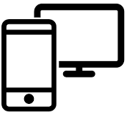
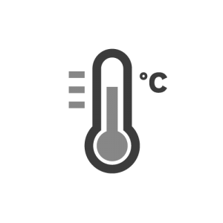

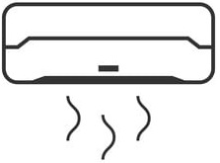
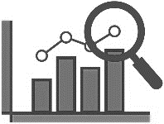
IoT System Architectural Level
Based on the architectural approach, IoT can be classified in five levels: Level 1 to Level 5.
Level 1
It is of minimal complexity.
The application has one sensor (temperature sensor, pressure sensor, etc).
The data sensed is stored locally and the data analysis is done locally.
Monitoring / control is done through an application.
This is used for simple applications.
Data generated in this level application is not huge.
For example, a temperature sensor senses the room temperature and the data is stored and analysed locally.
Air Conditioner
Data Collection
and
Analysis
Done Locally
Controlling
and
Monitoring Action
Temperature Sensor

Slide 40
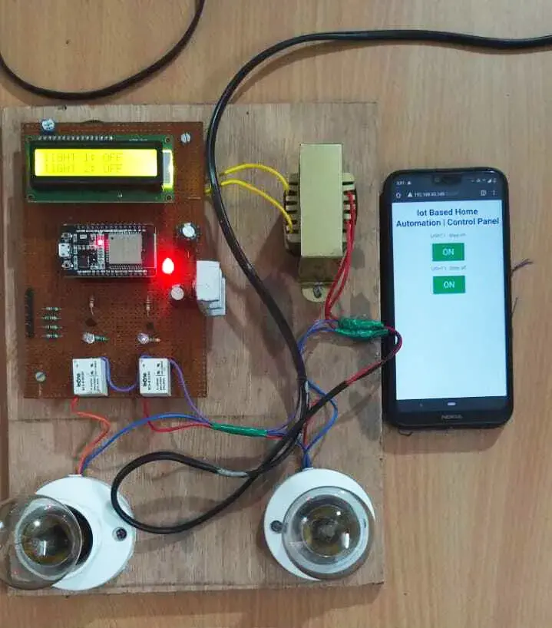
Home Automation

Slide 41
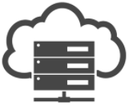
IoT System Architectural Level
Level 2
The second level is slightly more complex than the previous level.
The data is more voluminous and hence, cloud storage is preferred.
The frequency of sensing done by the sensor is faster.
The number of times sensing is done would be much more than Level 1.
The analysis is carried out locally, while cloud is meant for storage only.
Based on the data analysis, the control action can be triggered through the web application or mobile application.
Some examples are agriculture applications, room freshening solutions based on odor, etc.
Air Conditioner
Temperature Sensor
Data Analysis Done Locally
Cloud
Data Stored Here
(Bigger than Level 1)
Controlling
and
Monitoring Action

Slide 42


Smart Agriculture – Soil health monitor

Slide 43

IoT System Architectural Level
Level 3
The data is huge, frequency of sensing done by the sensor is faster and the data is stored on cloud.
The difference is that the analysis is also carried out on cloud.
Based on the data analysis, the control action can be triggered through the web application or mobile application.
Some examples are agriculture applications with Image processing.
Air Conditioner
Cloud
Data Stored and
Analysis
Both Done Here
Controlling
and
Monitoring Action
Temperature Sensor

Slide 44

Smart Agriculture – Insect detection

Slide 45



IoT System Architectural Level
Level 4
With every passing level, the volume of data increases and hence the rate at which it is sensed also increases.
At this level, multiple nodes are present which are independent of each other.
These nodes upload data to the cloud.
All the sensors upload the read sensory inputs on cloud storage.
Analysis is also carried out on the cloud.
Cloud
Data Collection and
Analysis Done Here
Temperature Sensor
Moisture Sensor
Controlling
and
Monitoring Action
PH Sensor

Slide 46

IoT System Architectural Level
Level 5
At this level, the amount of data is extensive and is sensed much faster.
Multiple nodes are involved in the applications categorized under Level 5 and these nodes are independent of each other.
The sensing of data and its storage is the same as in all the previous levels.
When an application is completely cloud oriented, it is computationally intensive in real time.
Cloud Data Collection and
Analysis Done Here
Temperature Sensor
Moisture Sensor
Co-ordinator Node
Controlling
and
Monitoring Action
PH Sensor

Slide 47
How Do IoT Devices Communicate with Each Other?
IoT devices communicate through complex networks using different protocols designed for specific tasks and environments.
Communications can be classified
Device-to-device
Device-to-gateway
Device-to-cloud or Data centre

Slide 48
IoT Protocols
Protocols are a set of rules for transmitting data between electronic devices according to a preset agreement regarding information structure and how each side will send and receive data.
Each IoT protocol enables either device-to-device, device-to-gateway or device-to-cloud/data center communication -- or combinations of those communications.
Factors such as geographic and special location, power consumption needs, battery-operated options, the presence of physical barriers and cost determine which protocol is optimal in an IoT deployment.
IoT protocols and standards are broadly classified into two separate categories.
Network protocols for IoT (Datalink layers (RF layer) / Physical layers )
IoT data protocols ( User Interface layer / Application layers)
Data protocols mainly focus on information exchange, while network protocols provide methods of connecting IoT edge devices with other edge devices or the Internet.

Slide 49

IoT Communication Technologies: Network Protocols
IoT network communication protocols connect medium and high-power IoT devices over a network. This technology typically operates over the internet.
There are three common ways to connect IoT devices: point-to-point, star networks, and mesh topology.

Slide 50
Network Protocols for IoT
IoT network protocols are used to connect devices over a network.
These sets of protocols are typically used over the internet.
Here are some examples of various IoT network protocols.
Bluetooth
Ethernet
Wi-Fi
Zigbee
Thread
Cellular networks (4G or 5G )
LoRa

Slide 51

Bluetooth and Bluetooth Low Energy (BLE)
Bluetooth is a wireless technology that allows data to be exchanged in small amounts over short distances at a high speed.
Its ability to transfer data faster comes at the cost of relatively high power consumption.
In 2010, Bluetooth was optimized for short-range IoT communications. Known as BLE, this version of the connectivity protocol boasts greater energy efficiency. However, their data transfer speed is also slower compared to Bluetooth.
Advantages: | Disadvantages:
Low latency | Uses the crowded 2.4 GHz frequency
Lower implementation costs due to hardware simplicity | Might not be suitable for large files
Easy internet access via a smartphone | A limited number of connected devices
Data encryption by default

Slide 52

ZigBee
ZigBee is a robust and scalable IoT protocol that is used to gather sensor data in home automation and industrial applications.
ZigBee transfers small amounts of data over moderate distances.
ZigBee operates on a self-healing mesh topology, which makes it highly reliable.
New devices can join the network after performing the “handshake” process, which takes merely 30 milliseconds
Advantages: | Disadvantages:
Can accommodate up to 65,000 devices | Uses the common 2.4 GHz frequency, which is prone to interferences
Low power consumption (small devices can operate on one battery for several years) | Requires a custom gateway, which is expensive
Relatively long range of communication

Slide 53

Z-Wave
This is a low-power wireless IoT protocol, which is commonly used for smart home solutions and business applications.
A single Z-Wave network can potentially handle a maximum of 232 devices, including the central controller.
This technology operates at a different frequency in each country, meaning that users must purchase a new device when changing their location.
Z-Wave is a proprietary technology managed by Z-Wave Alliance that oversees certifications.
Advantages: | Disadvantages:
Low latency | Low data transfer rate
Avoids the crowded 2.4 GHz frequency used by Wi-Fi, Bluetooth, and Zigbee | Premium prices
Low power consumption
Reasonable coverage

Slide 54

Wi-Fi (Wireless Fidelity)
Wi-Fi uses Internet Protocol (IP) to connect devices on a Local Area Network (LAN).
It ensures reliable and secure communication between closely located devices — for instance, gadgets within one IoT application deployment like smart home.
This IoT protocol is relatively cheap and easy to implement.
It works well with heavy files and can handle vast amounts of data.
However, this IoT communication protocol is too power-consuming and has inherent coverage limitations.
Advantages: | Disadvantages:
Convenient and easy to install | High power consumption
High data transfer rate | Lack of scalability
 | Short-distance communications

Slide 55

Long-Range Radio Wide Area Network (LoRaWAN)
This is a non-cellular wireless wide area network technology that connects devices over a long range, which makes it suitable for smart cities and industrial systems.
LoRaWAN can potentially connect millions of IoT devices and is optimized for low power consumption.
New devices can be either hard-coded or arranged into an over-the-air connection.
A LoRa gateway gathers data from different sensors and transmits it to a server or the cloud over a standard IP protocol.
LoRa Wide Area Network offers two security layers — one for the network layer and the other for the application.
This IoT communication protocol is not an option for applications that require low latency or transfer a large amount of data.

Slide 56

Long-Range Radio Wide Area Network (LoRaWAN)
Advantages: | Disadvantages:
Scalability | Low data transfer rate
Covers large distances | Custom LoRa gateway
Low power consumption | Not suitable for real-time applications
Operates on unlicensed frequency
LoRaWAN® Network Architecture

Slide 57
IoT Data protocols
This application layer protocol allows systems to communicate with each other regardless of the platform being used. They provide communication with hardware on the user side—without the need for any internet connection.
The connectivity in IoT data protocols and standards is through a wired or cellular network.
Advanced Message Queuing Protocol (AMQP)
Message Queuing Telemetry Transport (MQTT)
Constrained Application Protocol (CoAP)
Simple Object Access Protocol (SOAP)
Hypertext Transfer Protocol (HTTP)

Slide 58
Advanced Message Queuing Protocol (AMQP)
AMQP guarantees secure and reliable communication, even in cases where the network is weak or one of the systems is temporarily inaccessible. It specifies "forwarding addresses" that messages can be routed to in the event of a connection failure.
This protocol is popular in settings with server-based analytical environments, such as banking technology solutions. Otherwise, its application is rather limited due to its heaviness.
Advantages: | Disadvantages:
Reliability | Heavy memory requirements
Security | Slow data transmission due to large message size
Support for different messaging patterns (publish-subscribe, store-and-forward, and classic messaging queues)
Extendibility with minimal effort

Slide 59
Message Queuing Telemetry Transport (MQTT)
This lightweight IoT communication protocol ensures a reliable connection and operates on top of TCP/IP networks.
MQTT is suitable for wireless systems with constrained bandwidth and high latency, such as mobile devices operating on an unreliable network. That's why Facebook used it for its online chats.
Another application is remote monitoring, as MQTT shines at gathering small messages from devices with limited capacity at remote locations.
Advantages: | Disadvantages:
Low power consumption | Limited interoperability between devices from different vendors
Low bandwidth usage | Inherent security constraints (relies on short user names and passwords for authentication)
Ability to function well with unreliable connections | Poor extendibility
Data encryption by default | Limited choice of messaging patterns (only publish-subscribe)

Slide 60
Constrained Application Protocol (CoAP)
The Internet Engineering Task Force designed this IoT communication protocol to address the needs of HTTP-based systems.
CoAP allows for seamless integration with HTTP, minimizing any additional overhead.
It achieves this by supporting short wake-up and long sleep states. It enables HTTP clients to exchange information even with limited resources.
The IoT protocol is widely used in building automation and smart energy applications.
CoAP depends on User Datagram Protocol (UDP) packets for communication and message passing.
This technology is utilized for machine-to-machine applications and allows devices with limited capacity, like low availability, to join the IoT environment.
It can even work with microcontrollers with only 10 KiB of RAM.

Slide 61
Constrained Application Protocol (CoAP)
Advantages: | Disadvantages:
Highly secure as it uses DTSL parameters by default | Messages can reach a destination in the wrong order, which is a common issue with UDP
Easy to deploy | Difficulties communicating with devices behind Network Address Translation (NAT), which can generate dynamic IP addresses
Works efficiently with devices that have limited capabilities.

Slide 62
Data Distribution Service (DDS)
Object Management Group (OMG) developed this IoT communication protocol for real-time systems.
DDS offers a reliable and scalable data exchange using a publish-subscribe pattern.
Its scalability is attributed to the fact that DDS supports the dynamic discovery of publishers and subscribers.
It works well with the cloud and low-footprint devices and provides interoperable data sharing, which is software and hardware-independent.
This protocol is believed to be the first open international middleware IoT standard.
Advantages: | Disadvantages:
Scalable | Heavy on bandwidth (consumes twice as much traffic as MQTT)
Highly secure and powerful QoS mechanism | Only interfaces with web services via a gateway
Guarantees low-latency communication
Connects devices from different vendors

Slide 63
Enabling Technologies
IoT is a collection or group of many technologies and devices.
The simplest of sensors, embedded systems, data analytics, communication protocols, security aspects and cloud computing with storage have all become enabling technologies.
Enabling technologies/devices fall under one of the following categories:
Acquiring or Sensing Data
Analysing or Processing Data
Taking Control Action
Enhancing Security or Privacy
Technologies

Slide 64

Enabling Technologies - Sensors
Sensors are at the heart of any IoT application.
As the name suggests, they sense the environment and retrieve data.
Sensors are the starting point of any IoT application.
It fetches data for us to operate on.
Sensors could be Analog or Digital.
Temperature sensor in a thermometer is an example of it.
It is used to build temperature monitoring

Slide 65

Enabling Technologies - Sensors
Some examples of sensors that could be regarded as enabling technologies are as follows.
Weather tracking system uses temperature/humidity/moisture sensors.
Vehicle health monitoring sensors keep track of speed, tyre pressure, etc.
On Board Diagnostics (OBDs) used for collecting all critical information from an automobile to detect error.
Vibration sensors are used to track the quality of buildings/structures.
Water quality is monitored through sensors that measure pH, chloride level, etc.

Slide 66


Enabling Technologies - Cloud Computing
The next technology that is highly significant in IoT is Cloud Computing.
Cloud has grown much more popular because it serves as an affordable, effective and efficient medium for data storage.
Data storage plays a major role in IoT.

Slide 67
Service Models of Cloud Computing
There are three main service models of cloud computing.
Infrastructure as a Service (IaaS)
Platform as a Service (PaaS)
Software as a Service (SaaS).
Each model represents a different part of the cloud computing stack.
Each type of cloud service provides
Notes:
67

Slide 68
Example of “as a Service”
Pizza as a Service
Traditional
On-Premises
Infrastructure
as a Service (IaaS)
Platform
as a Service (PaaS)
Software
as a Service (SaaS)
Dining Table
Dining Table
Dining Table
Dining Table
Soda
Soda
Soda
Soda
Cheese
Cheese
Cheese
Cheese
You Manage
Toppings
Toppings
Toppings
Toppings
Tomato Sauce
Tomato Sauce
Tomato Sauce
Tomato Sauce
Vendor Manage
Pizza Dough
Pizza Dough
Pizza Dough
Pizza Dough
Oven
Oven
Oven
Oven
Fire
Fire
Fire
Fire
Made at Home
Take and Back
Pizza Delivered
Dined at Restaurant
Notes:
68

Slide 69

Examples

Slide 70

Enabling Technologies - Big Data Analytics
Data is everywhere, and from every function or operation we get more data.
IoT is all about collecting data from various sensory nodes.
Handling the huge data is fundamental to make the application a success.
The biggest challenge with big data is 4Vs. Volume, Variety, Speed (Velocity) at which it comes and its Veracity

Slide 71

Enabling Technologies - Big Data Analytics
Scale (Volume):
Huge volume of data is generated every minute.
Storage has become inexpensive and hence, cost-related challenges have reduced.
Cloud Storage availability.
Complexity (Variety):
Data no longer comes from one single source.
It also comes in different formats (e.g., audio, video, text and image)
Varieties of data becomes a huge challenge.
Data in doubt (Veracity):
How accurate is all this data anyway? Because we are now rely on it
The data’s nature alters dynamically and uncertainty is often seen.
So, it would be challenging to process this unstable data.
Speed (Velocity):
The rate at which data is generated Very Fast.
Also, data dynamics changes very frequently, new data is generated and moves around.

Slide 72


Enabling Technologies - Big Data Analytics
In IoT data is everything. so, data analytics is one of the enabling technologies for building a complete IoT application.
So the question is: “Who is generating all this data?” A partial list to answer this is as follows:
Sensors from security systems.
Sensors from weather monitoring systems.
Sensors from car/navigation systems.
Sensors from water quality monitoring systems.
Data from wearable Devices (e.g., bands).
Data from industrial equipment (e.g., motor health).
Sensors from bridges/roads about traffic density and other factors.
Social media (e.g., tweets, photo uploads, etc.).

Slide 73

Enabling Technologies - Embedded Computing Boards
An embedded computing board a very important component to bring IoT design to reality.
For making the prototype the computing boards play vital role.
The computing boards available in the market are driven by microcontrollers or processors.
Some of the boards are as follows:
Raspberry Pi.
Arduino (many variants).
NodeMCU.
Intel Edison.
Dragon Board
All these boards are small, yet smart.

Slide 74

Application areas of IoT
The scope and application areas of IoT is very huge.
IoT can be used to build applications
Agriculture
Assets Tracking
Energy Sector
Defence
Embedded Applications
Education
Waste Management
Healthcare Products
Telemedicine
Safety And Security Sector
Smart City Applications etc.

Slide 75


Smart Home Automation
A smart home system can be something that makes our life quite easy.
Starting from energy management where the power controls system in the AC appliances where we use the thermostat, all this is managed to cut down the power consumption that's taking place.
A door management system, security management system, water management system are the part of this as well. Still, these are vital things that stand out in the smart home system.

Slide 76
Smart Home Automation
The limitation of IoT in smart home application stops where our imagination stops. Anything that we wish to automate or want to make our life easier can be a part of smart home, a smartphone system as well.
Smart Lighting – Smart lighting for home helps in saving energy by adapting the life to the ambient condition and switching on/off or dimming the light when needed. Smart lighting solutions for homes achieve energy saving by sensing the human movements and their environments and controlling the lights accordingly.
Smart Appliances – Smart appliances with the management are here and also provide status information to the users remotely.
Smart washer/dryer can be controlled remotely and notify when the washing and drying are complete. Smart refrigerators can keep track of the item store and send updates to the users when an item is low on stock.

Slide 77
Smart Home Automation
Intrusion Detection – Home intrusion detection systems use security cameras and sensors to detect intrusion and raise alerts.
Alert can we inform of an SMS or an email sent to the user.
Advanced systems can even send detailed alerts such as an image shoot or short video clips.
Smoke/gas detectors – Smoke detectors are installed in homes and buildings to detect smoke that is typically an early sign of Fire.
It uses optical detection, ionization for Air sampling techniques to detect smoke.
Gas detectors can detect the presence of harmful gases such as CO, LPG, etc.
It can raise alerts in the human voice describing where the problem is.

Slide 78


Smart Agriculture
Smart agriculture, on the other hand, is mostly used to denote the application of IoT solutions in agriculture.
By using IoT sensors to collect environmental and machine metrics, farmers can make informed decisions, and improve just about every aspect of their work – from livestock to crop farming.
For example, by using smart agriculture sensors to monitor the state of crops, farmers can define exactly how many pesticides and fertilizers they have to use to reach optimal efficiency. The same applies to the smart farming definition.

Slide 79
IoT in agriculture
1. Monitoring of climate conditions : Probably the most popular smart agriculture gadgets are weather stations, combining various smart farming sensors. Located across the field, they collect various data from the environment and send it to the cloud.
The provided measurements can be used to map the climate conditions, choose the appropriate crops, and take the required measures to improve their capacity (i.e. precision farming).

Slide 80
IoT in agriculture
2. Greenhouse automation : Typically, farmers use manual intervention to control the greenhouse environment. The use of IoT sensors enables them to get accurate real-time information on greenhouse conditions such as lighting, temperature, soil condition, and humidity.
In addition to sourcing environmental data, weather stations can automatically adjust the conditions to match the given parameters. Specifically, greenhouse automation systems use a similar principle.
3. Crop management : One more type of IoT product in agriculture and another element of precision farming are crop management devices. Just like weather stations, they should be placed in the field to collect data specific to crop farming; from temperature and precipitation to leaf water potential and overall crop health.
Thus, you can monitor your crop growth and any anomalies to effectively prevent any diseases or infestations that can harm your yield.

Slide 81


IoT in agriculture
4. Cattle monitoring and management : There are IoT agriculture sensors that can be attached to the animals on a farm to monitor their health and log performance. Livestock tracking and monitoring help collect data on stock health, well-being, and physical location.
For example, such sensors can identify sick animals so that farmers can separate them from the herd and avoid contamination. Using drones for real-time cattle tracking also helps farmers reduce staffing expenses. This works similarly to IoT devices for petcare.

Slide 82

IoT in Industry 4.0
Industrial IoT, or the Industrial Internet of Things (IIoT), is a vital element of Industry 4.0.
IIoT harnesses the power of smart machines and real-time analysis to make better use of the data that industrial machines have been churning out for years.
The principal driver of IIoT is smart machines, for two reasons.
The smart machines capture and analyze data in real-time, which humans cannot.
The smart machines communicate their findings in a manner that is simple and fast, enabling faster and more accurate business decisions.

Slide 83
Applications of IIoT
Production : Smart machines, enabled with IIoT, can self-monitor and anticipate possible production hurdles. This results in lowered downtime and better efficiency.
Supply Chain : With IIoT, orders can automatically replenish stocks when needed. This reduces waste, maintains stock numbers, and makes sure the right amount of raw materials are always available. With the automation of supply chains and ordering, employees can focus on more complex areas of functioning.
Building Management : Most building management issues can be addressed with IIoT technology. Sensor-driven climate control removes all the uncertainty related to managing a building’s internal climate and takes all needed factors into consideration--such as the number of people, ventilation spots, machinery, and more. IIoT enhances building security with smart devices that assess possible threats from any entry points of a building.

Slide 84
Applications of IIoT
Healthcare : Healthcare has embraced smart devices for a long time now. Healthcare professionals can remotely monitor patients and are alerted by any status change. This makes healthcare more precise and personal. In the future, artificial intelligence may be able to assist with diagnoses, enabling doctors to treat patients more accurately and effectively.
Retail : IIoT technology in retail enables quick marketing decisions specific to each store. Companies can update storefronts based on region-specific consumer interests, and they can target audiences with smarter promotions. These data-driven insights make a store stand out from its competition.
Sensors are not new technology as companies have used them to track goods or monitor machines for years.
The difference in IIoT is the ability to adopt these changes on a larger scale due to the lowered costs of sensors, comprehensive wiring networks, and big-data analytics.

Slide 85
Summary
IoT refers to the interconnection of computing devices embedded in everyday objects via the Internet, enabling them to send and receive data.
IoT is not owned by any one engineering branch. It is a reality when multiple domains join forces and combine efforts.
IoT is all about providing service to any device, anywhere, anybody, and any network.
IoT has certain characteristics which are important:
Connectivity
Intelligence and identity
Scalability.
Dynamic and self-adapting (complexity)
Architecture
Safety

Slide 86
Summary
“Things” refer to variety of devices. At times, even humans in the loop becomes a thing.
For anything to qualify as a “thing”, it requires identity. The “thing” can monitor, measure, etc.
Example, a temperature sensor could be a “thing”.
One should understand that “THINGS” = HARDWARE + SOFTWARE + DATA + SERVICE
IoT stack has seven layers, starting with sensor layer and ending with application layer just as OSI.
Security/personnel safety, privacy, data extraction with consistency from complex environments, connectivity, power requirements, complexity involved and storage are the major challenges we face while building an IoT application.
IoT application can be classified as Level 1, 2, 3, 4 or 5 based on the complexity and architecture involved.
IoT is all about sense, connect, store, analyse data.

Slide 87
Internet of Things (IoT)
DU 2101CS631
Prof. Bhushan D. Joshi
Computer Engineering Department
bhushan.joshi@darshan.ac.in
+91 8485979997

